Slide 1
Using Google Drive to Stay Organized
Presented by: Joanne Chandler

Slide 2
Workshop Activities
Overview of Google Drive Home Screen
Creation of Folders
File and Folder Uploading Processes
Review of Google Apps
Google Docs
Google Sheets
Google Slides
Sharing processes
https://support.google.com/a/users/answer/9300017?hl=en
5

Slide 3
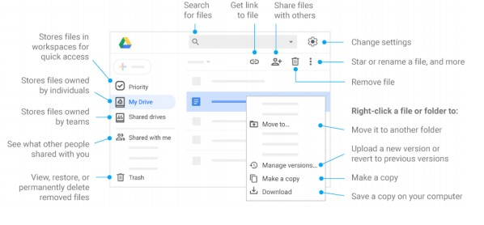
Overview of Google Drive Home Screen
15

Slide 4
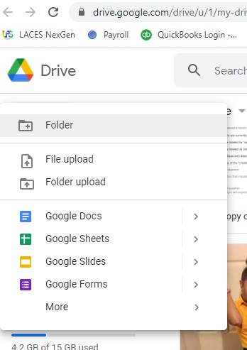
Creation of Folders
20

Slide 5
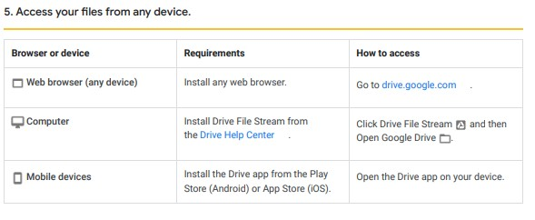
File and Folder Uploading Processes
30

Slide 6
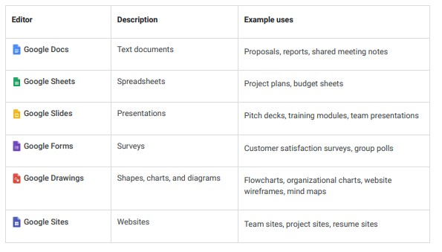
Review of Google Apps
50

Slide 7
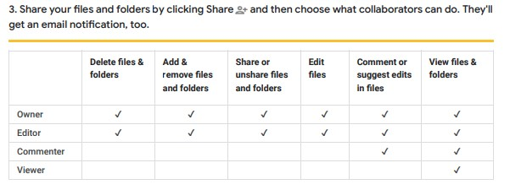
Sharing Processes
60

Slide 8
Using Google Drive to Stay Organized
Questions and Anwsers
Thank You for Attending

